Slide 1
Entity-Relationship Diagrams (ERDs)

Slide 2


Today’s agenda
Define the purpose of the Entity-Relationship (ER) Model
Differentiate between entities, instances, and attributes
Identify and classify attribute types (atomic, composite, stored, derived)
Explain domains and null values
Identify and create primary keys and foreign keys
Describe and model one-to-one, one-to-many, and many-to-many relationships
Create associative entities to resolve many-to-many relationships
Interpret and create ERDs using IDEF1X notation

Slide 3
REVIEW FROM DAY 2
Concept | Summary
Database | Organized collection of data
DBMS | Software to manage databases
Relational Database | Data stored in related tables
Entity | A thing we store information about
Attribute | A characteristic of an entity

Slide 4
The Problem with Poor Design
What happens when we design a database poorly?
Problem | Example
Redundancy | Same customer information stored in multiple places
Inconsistency | Customer phone number is different in different tables
Update Anomalies | Must update the same data in multiple locations
Insert Anomalies | Can't add a new product until it has been ordered
Delete Anomalies | Deleting an order accidentally deletes customer info
The Solution:
Use the Entity-Relationship Model to plan your database before building it.

Slide 5
Real-World Entities
Think about a university registration system.
What "things" does the university need to track?
Entity | Description
STUDENT | People enrolled at the university
COURSE | Classes offered by the university
INSTRUCTOR | People teaching the courses
DEPARTMENT | Academic units (Math, English, etc.)
ENROLLMENT | Which students are in which courses
What other entities might a university need to track?

Slide 6
What is the Entity-Relationship Model?
The Entity-Relationship (ER) Model is a tool that organizes and documents the logical design of a database.
Why use it?
It's a blueprint for your database
It helps communicate with business stakeholders
It documents the design for future reference
It ensures you're solving the right problems before you start building
Component | Description
Entities | The "things" we store information about
Attributes | The characteristics of those things
Relationships | How entities are connected to each other

Slide 7
Entities vs. Instances
This is a critical distinction to understand. Remember: An entity is a type. An instance is a specific example of that type.
ENTITY: CUSTOMER
│
├── Instance: Customer #100 — Joan Adams
├── Instance: Customer #200 — Miles Smith
├── Instance: Customer #300 — Sarah Jones
└── Instance: Customer #400 — David Chen
Term | Definition | Example
Entity (Entity Type) | A category or class of things | CUSTOMER
Instance (Entity Instance) | One specific occurrence of an entity | Joan Adams (Customer #100)

Slide 8
Physical vs. Conceptual Entities
Not every entity is a physical object.
Physical Entity
A real-world object that can be seen or touched
Examples: CUSTOMER, EMPLOYEE, VEHICLE, PRODUCT
Conceptual Entity
An idea, event, or business concept that may not be a physical object
Examples: COURSE, ORDER, ENROLLMENT, ACCOUNT
Key Point:
An entity is anything about which the organization needs to store data.
Question for the class:
Is an ORDER a physical entity or a conceptual entity? Why?

Slide 9
Attributes in Detail
Attributes are the pieces of data that describe an entity.
Example: The CUSTOMER Entity
In this example:
The Entity is CUSTOMER
The Attributes are: Customer Number, Last Name, First Name, Address, Phone
Each row is one instance of the CUSTOMER entity
Customer Number | Last Name | First Name | Address | Phone
100 | Adams | Joan | 9825-77 Ave Edmonton AB T5C 8E2 | 780-488-8712

Slide 10
Atomic vs. Composite Attributes
Atomic Attribute
Cannot be meaningfully broken down
Contains a single, indivisible value
Atomic Attribute | Value
Customer Number | 100
First Name | Joan
Phone | 780-488-8712

Slide 11
Atomic vs. Composite Attributes
Composite Attribute
Can be broken down into smaller, meaningful parts
The parts are often atomic attributes
Composite Attribute | Can Be Broken Down Into
Address | Street Address, City, Province, Postal Code
Full Name | First Name, Last Name
Business Rule Consideration:
A national company stores address as atomic parts. An international company may store address as a single composite attribute because formats vary.

Slide 12
Stored vs. Derived Attributes
Stored Attribute
Value is physically stored in the database
Directly entered and saved
Stored Attribute | Value
Order Number | ORD-1001
Item Price | $10.00
Quantity | 5

Slide 13
Stored vs. Derived Attributes
Derived Attribute
Value is calculated from other stored attributes
Not stored directly (saves space, ensures consistency)
Derived Attribute | How It's Calculated
Order Amount | Quantity × Price
Age | Current Date − Date of Birth

Slide 14
Stored vs. Derived Attributes
Trade-off:
Store Derived Attribute | Don't Store Derived Attribute
Uses more storage space | Saves storage space
Faster retrieval | Calculated each time (slower)

Slide 15
Domains and Null Values
What values can an attribute hold?
Every attribute has a set of legitimate values, defined by:
Customer Number Example:
Data Type: Integer
Domain: Greater than zero
Legitimate values: 1, 2, 3, 100, 2000, etc.
Illegitimate values: -5, 0, "ABC"
Concept | Definition | Example
Data Type | The kind of data the attribute can store | Integer, String, Date
Domain | The set of allowable values | Must be > 0, Must be between A-F

Slide 16
The NULL Value
NULL is a special value that represents the ABSENCE of a value.
NULL is not the same as zero, blank, or empty string.
Two Interpretations of NULL:
Interpretation | Example
Value is unknown | A new customer doesn't know their postal code yet. NULL is stored until they provide it.
Attribute does not apply | A single employee has no spouse. NULL is stored in the "Spouse Name" attribute.

Slide 17
The NULL Value
Important Caution:
NULL propagates through expressions. Any expression using an attribute that contains NULL will result in NULL.
Example: Price + NULL = NULL (not 0!)

Slide 18
Primary Keys (PK)
A Primary Key (PK) is an attribute (or group of attributes) that uniquely identifies each instance of an entity.
A primary key must:
Examples:
Entity | Primary Key | Reason
STUDENT | Student ID | Each student has a unique ID
PRODUCT | Product Number | Each product has a unique number
EMPLOYEE | Employee ID | Each employee has a unique ID
Rule | Description
Unique | No two instances can have the same PK value
Not Null | Every instance must have a PK value (can't be NULL)
Stable | The value shouldn't change over time

Slide 19
Special Kinds of Primary Keys
Technical Key (Surrogate Key)
A PK created by the database designer when there is no naturally occurring unique attribute
Often an auto-incrementing number
Composite Key (Concatenated Key)
A PK made up of two or more attributes
The combination of all attributes must be unique
Natural Key? | Technical Key
Customer Name (not unique — there could be two John Smiths) | Customer ID (1, 2, 3, ...)
Entity | Composite PK | Why?
ENROLLMENT | Student ID + Course Code | A student can take many courses. A course has many students. The combination is unique.

Slide 20
Exercise — Identify the PK
For each table below, what is the primary key?
CUSTOMER
Customer ID | First Name | Last Name | Phone
100 | Joan | Adams | 780-488-8712
200 | Miles | Smith | 780-438-9523
300 | Sarah | Jones | 587-555-1234
ENROLLMENT
Student ID | Course Code | Grade
S1001 | MATH101 | A
S1001 | ENGL102 | B
S1002 | MATH101 | A
Notes:
Answer: Student ID + Course Code (Composite Key)

Slide 21
Introduction to Relationships
A relationship represents a business association between two entities.
All relationships are bi-directional — they can be read from either side.
Example: The Hardware Store Order
CUSTOMER — places — ORDER
From CUSTOMER perspective: One customer can place many orders.
From ORDER perspective: One order is placed by one customer.
This is a ONE-TO-MANY relationship.

Slide 22
Types of Relationships
Three Main Types of Relationships:
Type | Symbol | Description | Example
One-to-One (1:1) | 1:1 | One instance of Entity A relates to one instance of Entity B | Country → Capital City
One-to-Many (1:M) | 1:M | One instance of Entity A relates to many instances of Entity B | Customer → Orders
Many-to-Many (M:N) | M:N | Many instances of Entity A relate to many instances of Entity B | Student → Courses

Slide 23
One-to-One Relationships (1:1)
One instance of Entity A is related to one and only one instance of Entity B.
This is the RAREST type of relationship.
Example 1: Country and Capital City
Each country has exactly one capital city.
Each capital city belongs to exactly one country.
Example 2: Employee and Parking Stall
Each employee is assigned one parking stall.
Each parking stall is assigned to one employee.
Country | Capital City
Canada | Ottawa
France | Paris
Japan | Tokyo

Slide 24
One-to-Many Relationships (1:M)
One instance of Entity A is related to zero, one, or many instances of Entity B.
This is the MOST COMMON type of relationship.
Example 1: Customer and Orders
CUSTOMER (1) — places — ORDER (M)
One customer can place many orders.
One order is placed by exactly one customer.
Example 2: Department and Employees
DEPARTMENT (1) — employs — EMPLOYEE (M)
One department has many employees.
One employee belongs to exactly one department.

Slide 25
Associative Entities
An Associative Entity is a third entity created to resolve a many-to-many relationship.
It contains:
The primary keys of the two related entities (as foreign keys)
Any other attributes that describe the association
Example: STUDENT — enrolls in — COURSE
STUDENT |  | COURSE
Student ID (PK) |  | Course Code (PK)
First Name | ←→ | Course Name
Last Name |  | Credits
... |  | ...

Slide 26
Associative Entities
Associative Entity: ENROLLMENT
PK of ENROLLMENT = Student ID + Course Code (Composite Key)
ENROLLMENT
Student ID (FK)
Course Code (FK)
Grade
Enrollment Date

Slide 27
A Foreign Key Can Also Be a Primary Key
An attribute can be both a PK and an FK.
This commonly happens in an associative entity.
Example: ENROLLMENT
Attribute | Role
Student ID | PK + FK
Course Code | PK + FK
Grade | Non-key attribute
Enrollment Date | Non-key attribute
Composite Primary Key:
Student ID + Course Code
Each FK points to the PK of its parent entity:
Student ID → STUDENT.Student ID
Course Code → COURSE.Course Code
Why?
The combination identifies one unique enrollment.

Slide 28
Foreign Keys (FK)
A Foreign Key (FK) is the mechanism that defines a relationship between entities.
Definition:
A primary key of one entity (the parent) that appears as an attribute of another entity (the child).
Parent vs. Child:
Role | Description | Example
Parent | The "one" side of a 1:M relationship | CUSTOMER
Child | The "many" side of a 1:M relationship | ORDER

Slide 29
Foreign Keys (FK)
How it works:
CUSTOMER (Parent) |  | ORDER (Child)
Customer ID (PK) | ← | Customer ID (FK)
Last Name |  | Order ID (PK)
First Name |  | Order Date
Phone |  | Total Amount
Key Point:
The FK in the child table refers to the PK in the parent table. This creates the relationship.

Slide 30
Foreign Key Rules
A foreign key does more than simply "connect two boxes."
A foreign key:
References a primary key in another table/entity
Helps enforce the relationship between parent and child
Must use a compatible data type with the referenced primary key
Does not have to have the same attribute name as the primary key it references
Example:
CUSTOMER.CustomerID → ORDER.CustomerID
The names match here, but they do not have to.
Important:
The FK value must correspond to a valid PK value in the parent when the relationship requires a matching parent.

Slide 31
FK Example — One-to-Many
Scenario: A retail sales company. A customer can place many orders. Each order is placed by one customer.
Which is the parent? | Which is the child?
CUSTOMER (the "one" side) | ORDER (the "many" side)
Implementation:
CUSTOMER (Parent)
Customer ID (PK) | ← Parent Primary Key
Last Name
First Name
Phone

Slide 32
FK Example — One-to-Many
Implementation cont:
ORDER (Child)
Order ID (PK) | Child Primary Key
Order Date
Customer ID (FK) | ← Foreign Key (from Customer)
Result: Every order includes the Customer ID of the customer who placed it.

Slide 33
FK Example — One-to-One
Scenario: A company has departments. Each department has one manager. Each manager manages one department.
Option 1: Add Department ID to Employee (Bad Design)
Option 2: Add Employee ID to Department (Better Design)
EMPLOYEE
Employee ID (PK)
Name
ManagesDept (FK) | ← Many employees will have NULL here!
DEPARTMENT (Child)
Department ID (PK)
Department Name
ManagerID (FK) | ← Every department has a manager

Slide 34
FK Example — One-to-One
Why is Option 2 better?
Every department has a manager, so no NULL values.
Not all employees are managers, so Option 1 would have many NULLs.
Important implementation detail:
If ManagerID is used as a foreign key to enforce a 1:1 relationship, it should be UNIQUE so that the same manager cannot be assigned to multiple departments.
EMPLOYEE
Employee ID (PK)
Name
ManagesDept (FK) | ← Many employees will have NULL here!
DEPARTMENT (Child)
Department ID (PK)
Department Name
ManagerID (FK) | ← Every department has a manager

Slide 35
Participation
Before we talk about "how many," we need to ask another question:
Does the relationship have to exist?
Participation describes whether an instance is required to participate in a relationship.
Important distinction:
Participation tells us whether the relationship is required.
Cardinality tells us how many related instances are possible.
These two ideas work together to describe a relationship.
Participation | Meaning | Example
Mandatory | Every instance must participate | Every ORDER must belong to a CUSTOMER
Optional | An instance may or may not participate | A CUSTOMER may have no ORDERS yet

Slide 36
Cardinality = Minimum + Maximum
Cardinality defines the number of instances of one entity that can be related to a single instance of another entity.
A useful way to read cardinality is as a minimum and maximum.
Minimum = Is participation required?
O = zero → optional
| = one → mandatory
Maximum = How many are allowed?
| = one
Crow's foot = many
Common combinations:
Symbol | Minimum | Maximum | Meaning
`O | ` | 0 | 1
` |  | ` | 1
O< | 0 | Many | Zero, one, or many
` | <` | 1 | Many

Slide 37
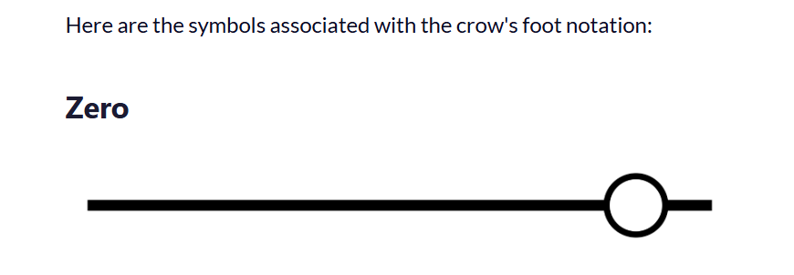
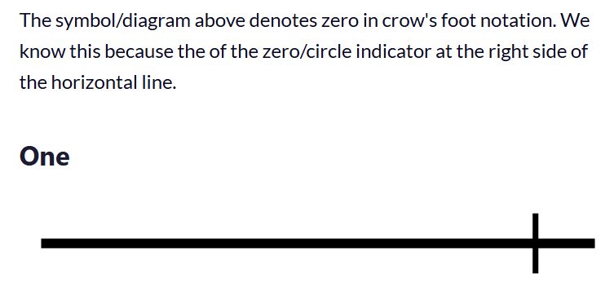
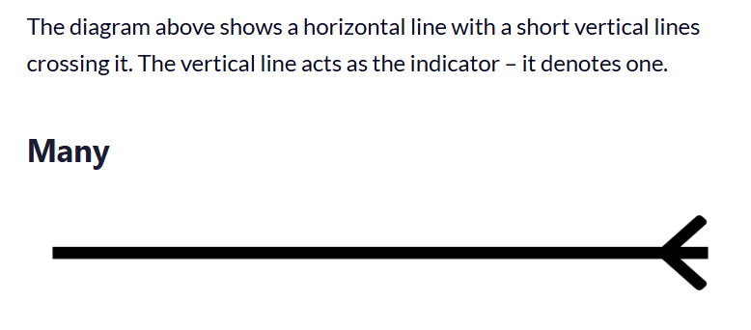
Crow's Foot Notation Symbols
Easy memory rule:
Circle = zero, Bar = one, Crow's foot = many.

Slide 38
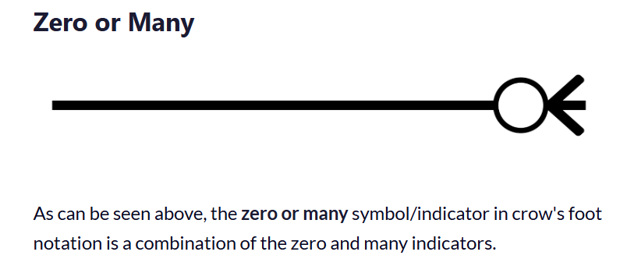
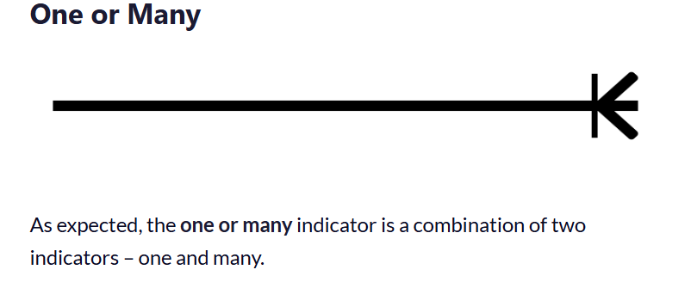
Crow's Foot Notation Symbols
Combined symbols:
O| = zero or one
|| = one and only one
O< = zero or many
|< = one or many
Remember:
The symbols tell us the minimum and maximum number of related instances.
Important:
Crow's Foot is being used here to make cardinality easier to understand. IDEF1X is the notation used for the ERDs in this course.

Slide 39
Reading Cardinality
Combined symbols:
O| = zero or one
|| = one and only one
O< = zero or many
|< = one or many
Remember:
The symbols tell us the minimum and maximum number of related instances.
Important:
Crow's Foot is being used here to make cardinality easier to understand. IDEF1X is the notation used for the ERDs in this course.
How to read a Crow's Foot relationship:
CUSTOMER |---O< places O---| ORDER
Step 1: Start at CUSTOMER, look at ORDER side
Interpretation:
A customer can place zero or many orders.
Step 2: Start at ORDER, look at CUSTOMER side
Interpretation:
An order is placed by one and only one customer.
Final Business Rule:
A customer may place many orders. An order must be placed by exactly one customer.
Symbol at ORDER side | Meaning
O< | Zero or many

Slide 40
Business Rules Determine Cardinality
Cardinality does not come from the diagram itself.
Business rules determine the relationship.
The design process is:
Business Rule → Relationship → Cardinality → ERD
Example: Customer and Order
Business rule:
A customer may place zero or many orders.
Every order must belong to exactly one customer.
Therefore:
CUSTOMER 1 : M ORDER
with the appropriate optional/mandatory participation.

Slide 41
Business Rules Determine Cardinality
Another example: Student and Course
Business rules:
A student can enroll in many courses.
A course can have many students.
Therefore:
STUDENT M : N COURSE
which must be resolved with an associative entity.
Key Point:
Do not choose cardinality because a symbol "looks right." Derive it from the business rules.

Slide 42
Cardinality Examples
Example 1: Country and Capital City (1:1)
COUNTRY |---| has |---| CAPITAL
Country has exactly one capital.
Capital belongs to exactly one country.
Example 2: Department and Employee (1:M)
DEPARTMENT |---| employs 0<--- EMPLOYEE
A department employs zero or many employees.
An employee belongs to exactly one department.

Slide 43
Cardinality Examples
Example 3: Student and Course (M:N)
STUDENT 0<--- enrolls in --->0 COURSE
A student enrolls in zero or many courses.
A course has zero or many students.

Slide 44





Cardinality Types (Detailed)
Cardinality | Definition | Example
To one | One instance is related to one instance of another | Driver's License: one person → one license
To zero or one | One instance is related to zero or one instance | Parking stalls: employee may or may not have a stall
To one or many | One instance is related to one or many instances | Timecards: one employee → one or more timecards
To zero, one, or many | One instance is related to zero, one, or many instances | Employees to projects: may be assigned to zero, one, or many projects
To many | One instance is related to many instances | Course to students: one course → many students
… to one or many
(mandatory many)
… to zero, one, or many (optional many)
… to one
(mandatory 1)
… to many
… to zero or one (optional 1)

Slide 45
How to Read Cardinality
When reading an ERD:
Step 1: Start at one entity.
Step 2: Look at the symbols at the other end of the relationship.
Step 3: Read the symbols as the minimum and maximum number of related instances.
Example:
CUSTOMER |---O< ORDER
Starting with CUSTOMER:
One customer can have zero or many orders.
Starting with ORDER:
One order must belong to exactly one customer.
Always read the relationship in both directions.
Read it as a sentence:
A CUSTOMER places zero or many ORDERs.
An ORDER is placed by one and only one CUSTOMER.
Key Point:
The meaning comes from the symbol at the other entity's end of the relationship.

Slide 46
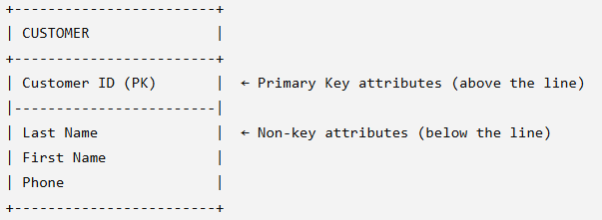
IDEF1X Notation
IDEF1X is the notation used in this course.
Entity Symbols:
Symbol | Type | Description
[CUSTOMER] | Base Entity | Square corners. Standard entity with its own primary key.
[ENROLLMENT] | Associative Entity | Rounded corners. Created to resolve M:N relationships.

Slide 47
IDEF1X Notation
Foreign Key Suffix:
Any attribute that acts as a foreign key is suffixed with (FK).
Relationship Lines:
Dashed line = Non-identifying relationship
Solid line = Identifying relationship
Relationship Names:
Relationship names should be written as verb phrases such as "places," "contains," "enrolls in," or "teaches."
Read relationships in both directions.
Example:
CUSTOMER places ORDER
ORDER is placed by CUSTOMER

Slide 48
Identifying vs. Non-Identifying Relationships
Type | Symbol | Description | Example
Non-Identifying | Dashed Line | The FK in the child entity does not act as part of the PK for that entity. | Customer → Order
Identifying | Solid Line | The FK does act as part of the PK for the child entity. | Order → OrderDetails
Non-Identifying (Dashed Line):
CUSTOMER ········ places ········ ORDER
Customer ID (FK) in Order is NOT part of Order's PK.
Order has its own Order ID as PK.
Identifying (Solid Line):
ORDER ——— contains ——— ORDER_DETAILS
Order ID (FK) in OrderDetails IS part of OrderDetails' PK.
OrderDetails PK = Order ID + Item Number (Composite Key)

Slide 49
What Makes a Relationship Identifying?
The key question is:
Is the foreign key part of the child's primary key?
Non-Identifying Relationship
The FK in the child is not part of the child's PK.
The child has its own independent PK.
Example: CUSTOMER → ORDER
Identifying Relationship
The FK is part of the child's PK.
The child's identity depends on the parent.
Example: ORDER → ORDER_DETAILS
Easy test:
If the FK is part of the child's PK → Identifying.
If the FK is not part of the child's PK → Non-identifying.

Slide 50
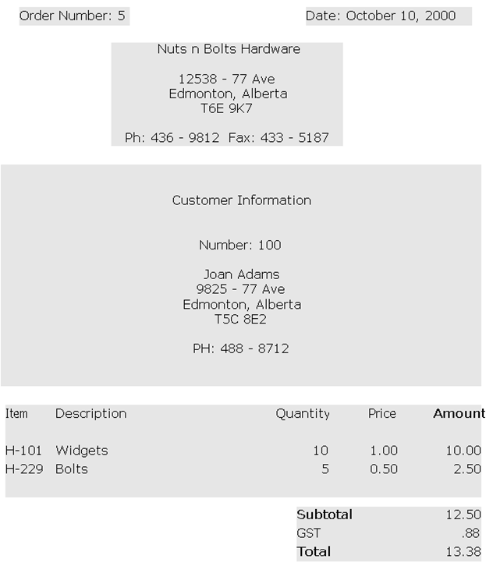

Slide 51
Reading an IDEF1X ERD
Relationships:
CUSTOMER ····· places ····· ORDER (Non-Identifying, 1:M)
ORDER ——— contains ——— ORDER_DETAILS (Identifying, 1:M)
ITEM ——— appears on ——— ORDER_DETAILS (Identifying, 1:M)

Slide 52
FK Example — One-to-Many
Scenario: A retail sales company. A customer can place many orders. Each order is placed by one customer.
Which is the parent? | Which is the child?
CUSTOMER (the "one" side) | ORDER (the "many" side)
Implementation:
Result: Every order includes the Customer ID of the customer who placed it.
CUSTOMER (Parent)
Customer ID (PK) | ← Parent Primary Key
Last Name
First Name
Phone
ORDER (Child)
Order ID (PK) | Child Primary Key
Order Date
Customer ID (FK) | ← Foreign Key (from Customer)

Slide 53
FK Example — One-to-One
Scenario: A company has departments. Each department has one manager. Each manager manages one department.
Option 1: Add Department ID to Employee (Bad Design)
Option 2: Add Employee ID to Department (Better Design)
EMPLOYEE
Employee ID (PK)
Name
ManagesDept (FK) | ← Many employees will have NULL here!
DEPARTMENT (Child)
Department ID (PK)
Department Name
ManagerID (FK) | ← Every department has a manager

Slide 54
FK Example — One-to-One
Option 1: Add Department ID to Employee (Bad Design)
Option 2: Add Employee ID to Department (Better Design)
EMPLOYEE
Employee ID (PK)
Name
ManagesDept (FK) | ← Many employees will have NULL here!
DEPARTMENT (Child)
Department ID (PK)
Department Name
ManagerID (FK) | ← Every department has a manager
Why is Option 2 better?
Every department has a manager, so no NULL values.
Not all employees are managers, so Option 1 would have many NULLs.
Important implementation detail:
If ManagerID is used as a foreign key to enforce a 1:1 relationship, it should be UNIQUE so that the same manager cannot be assigned to multiple departments.

Slide 55
Step-by-Step ERD Construction
Step 1: Identify Entities
Read the business rules. Underline the "nouns" — these are potential entities.
Step 2: Identify Attributes
What information do we need to store about each entity?
Step 3: Identify Primary Keys
What uniquely identifies each instance of an entity? Is there a natural key? Do we need a technical key?
Step 4: Identify Relationships
How are entities connected? What are the "verbs" between them?
Name relationships with verb phrases and make sure they make sense in both directions.
Step 5: Determine Cardinality
How many instances can participate in each relationship? (1:1, 1:M, M:N)
Step 6: Create Associative Entities
If you have a M:N relationship, create an associative entity to resolve it.
Step 7: Draw the ERD
Use IDEF1X notation with proper symbols.

Slide 56
Example — College Registration System
Business Rules:
A university has many departments.
Each department offers many courses.
A course is offered by exactly one department.
A student can enroll in many courses.
A course can have many students enrolled.
Students are identified by Student ID.
Courses are identified by Course Code.
Step 1: Identify Entities
Entity | Description
DEPARTMENT | Academic units
COURSE | Classes offered
STUDENT | People enrolled
ENROLLMENT | Which students are in which courses

Slide 57
Example — College Registration (Continued)
Step 2: Identify Attributes
DEPARTMENT | COURSE | STUDENT | ENROLLMENT
Dept ID (PK) | Course Code (PK) | Student ID (PK) | Student ID (FK)
Dept Name | Course Name | First Name | Course Code (FK)
Location | Credits | Last Name | Grade
 | Dept ID (FK) | DOB | Enrollment Date
 |  | Email

Slide 58
Example — College Registration (Continued)
Step 3: Identify Relationships
Entity A | Relationship | Entity B | Type
DEPARTMENT | offers | COURSE | 1:M
STUDENT | enrolls in | COURSE | M:N → Resolved by ENROLLMENT

Slide 59
Example — College Registration (Continued)
Step 3: Identify Relationships
Entity A | Relationship | Entity B | Type
DEPARTMENT | offers | COURSE | 1:M
STUDENT | enrolls in | COURSE | M:N → Resolved by ENROLLMENT

Slide 60
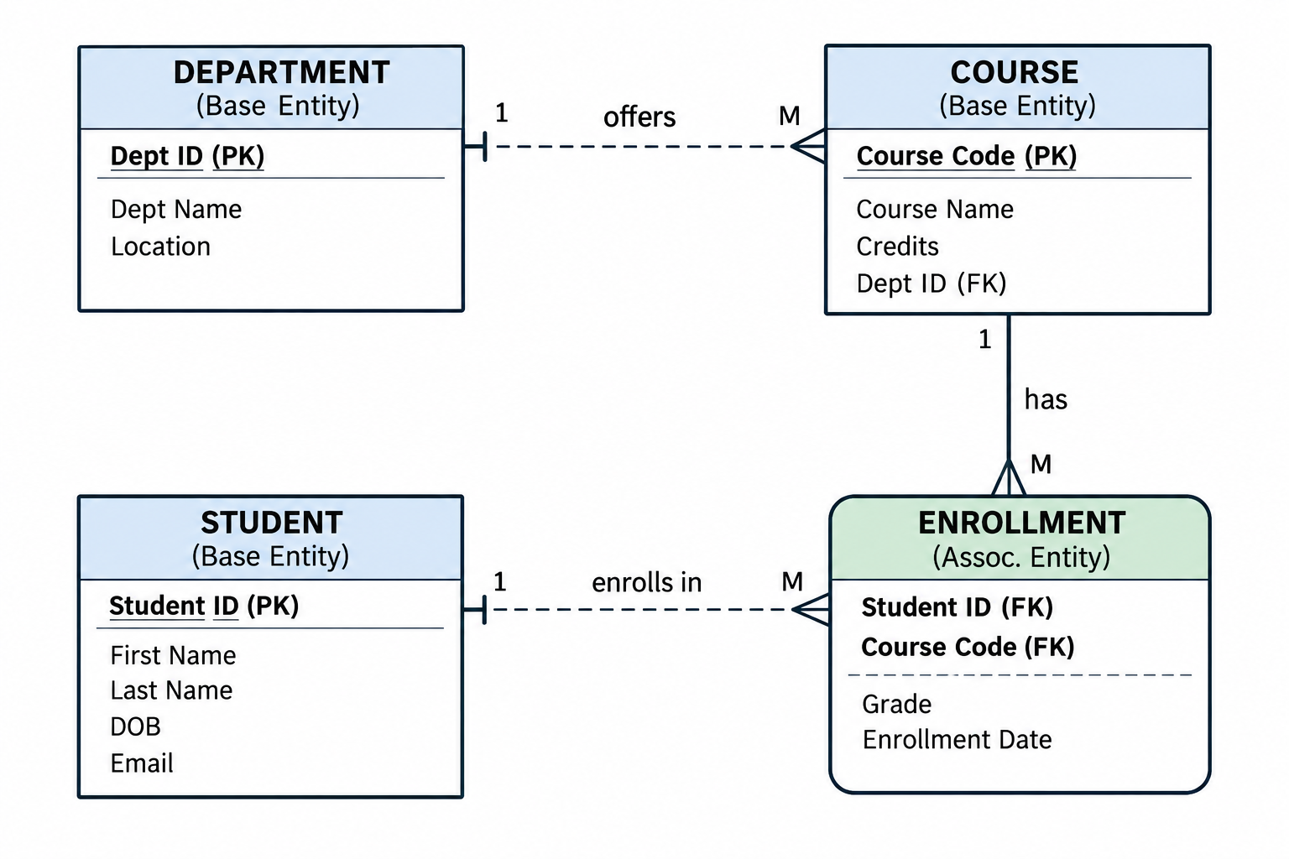
Example — College Registration ERD
IDEF1X ERD:

Slide 61
How to Read an ERD
When you are given an ERD, work through it in this order:
Identify the entities
Identify the attributes
Find the primary keys
Find the foreign keys
Identify the relationships
Read the cardinality and participation
Check identifying vs. non-identifying relationships
Read each relationship as a sentence in both directions
Example:
CUSTOMER 1:M ORDER
Read it as: A customer can place many orders.
Then reverse it: An order belongs to one customer.
Goal:
Be able to look at an ERD and explain the database design in plain language.

Slide 62
FK Placement Summary
Where does the foreign key go?
Rule of Thumb:
The parent entity does NOT contain the FK. The child entity DOES contain the FK.
Example: CUSTOMER (1) → ORDER (M)
Parent: CUSTOMER (no FK to Order)
Child: ORDER (contains Customer ID as FK)
Relationship Type | FK Placement
1:1 | Place the FK where the business rules make the most sense; avoid unnecessary NULLs. If the FK enforces the 1:1 relationship, it should be UNIQUE.
1:M | Place the FK in the "many" entity (child).
M:N | Create an Associative Entity containing both PKs.

Slide 63
Key Takeaways:
Question | Answer
What is an entity? | A person, place, thing, or concept about which we store data.
What is an instance? | One specific occurrence of an entity.
What is a primary key? | An attribute that uniquely identifies each instance of an entity.
What is a foreign key? | A primary key from one entity that appears in another entity.
What is an associative entity? | A third entity created to resolve a many-to-many relationship.
What is cardinality? | The number of instances of one entity that can relate to another.
What is a composite attribute? | An attribute that can be broken down into smaller parts.
What is a derived attribute? | An attribute calculated from other stored attributes.

Slide 64
Today We Learned:
Concept | Key Point
ER Model | A blueprint for database design
Entities | The "things" we store information about
Attributes | The characteristics of entities
PKs and FKs | Unique identifiers and relationship links
1:1 Relationships | Rare — one to one
1:M Relationships | Most common — one to many
M:N Relationships | Must be resolved with an associative entity
Cardinality | Defines how many instances can participate
Participation | Defines whether participation is required or optional
IDEF1X Notation | The notation used in this course
Identifying Relationship | FK is part of the child's PK
Non-Identifying Relationship | FK is not part of the child's PK

